Slide 1
ANALYSIS OF WOMEN SAFETY IN INDIAN CITIES USING MACHINE LEARNING ON TWEETS

Slide 2
Contents
ABSTRACT
INTRODUCTION
LITERATURE SURVEY
PROPOSED SYSTEMS
ALGORITHM
RESULTS
CONCLUSION
FUTURE ENHANCEMENT
REFERENCES

Slide 3
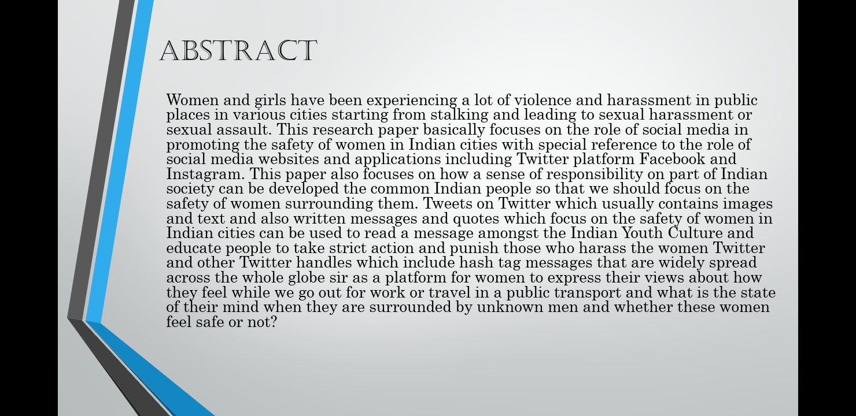
ABSTRACT

Slide 4
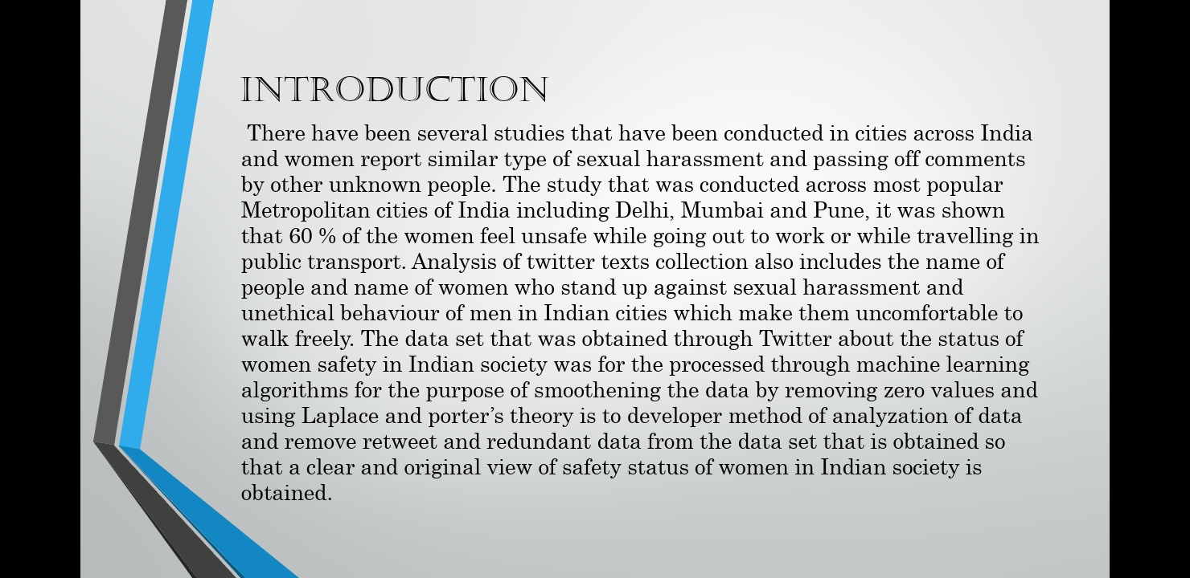
INTRODUCTION

Slide 5
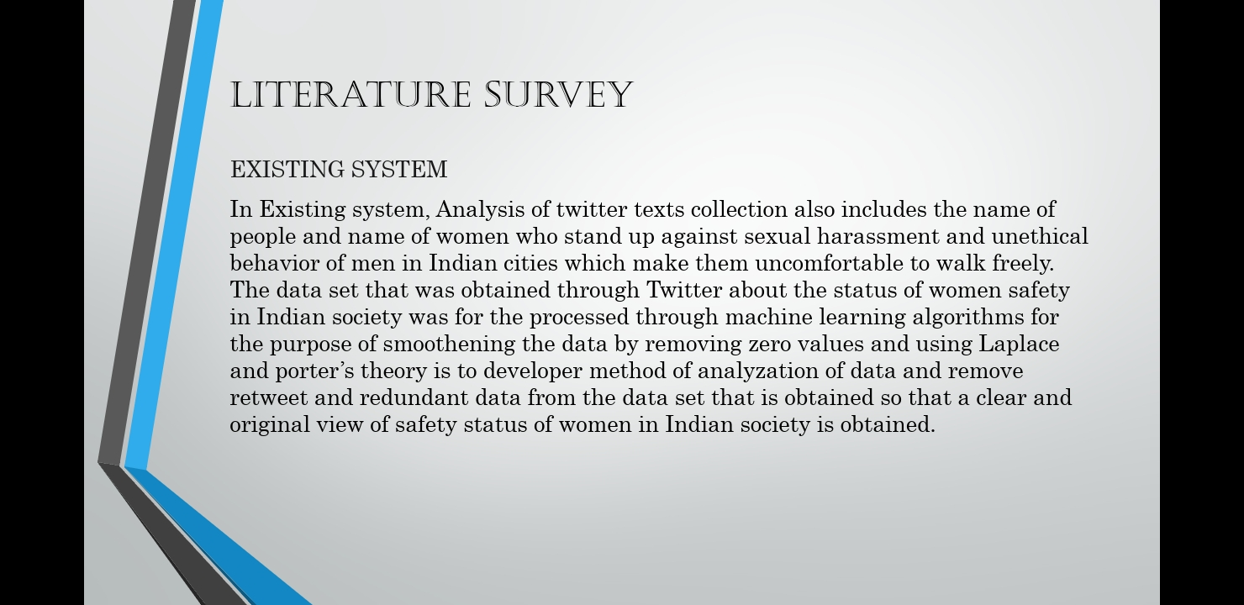
LITERATURE SURVEY

Slide 6
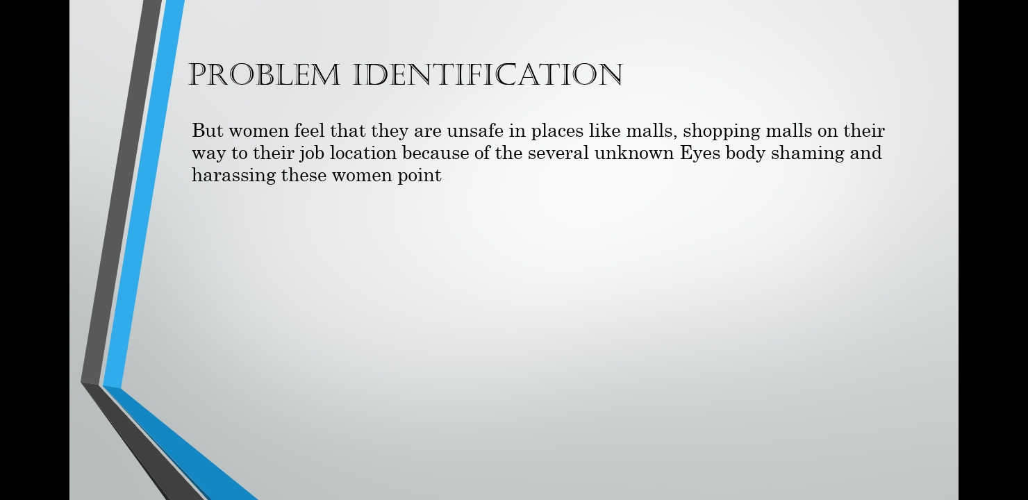
PROBLEM IDENTIFICATION

Slide 7
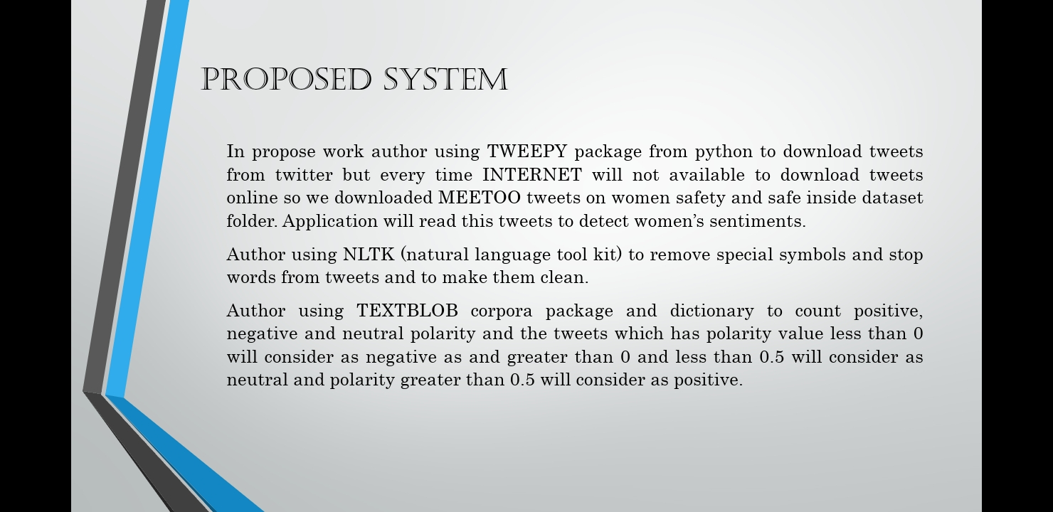
PROPOSED SYSTEM

Slide 8
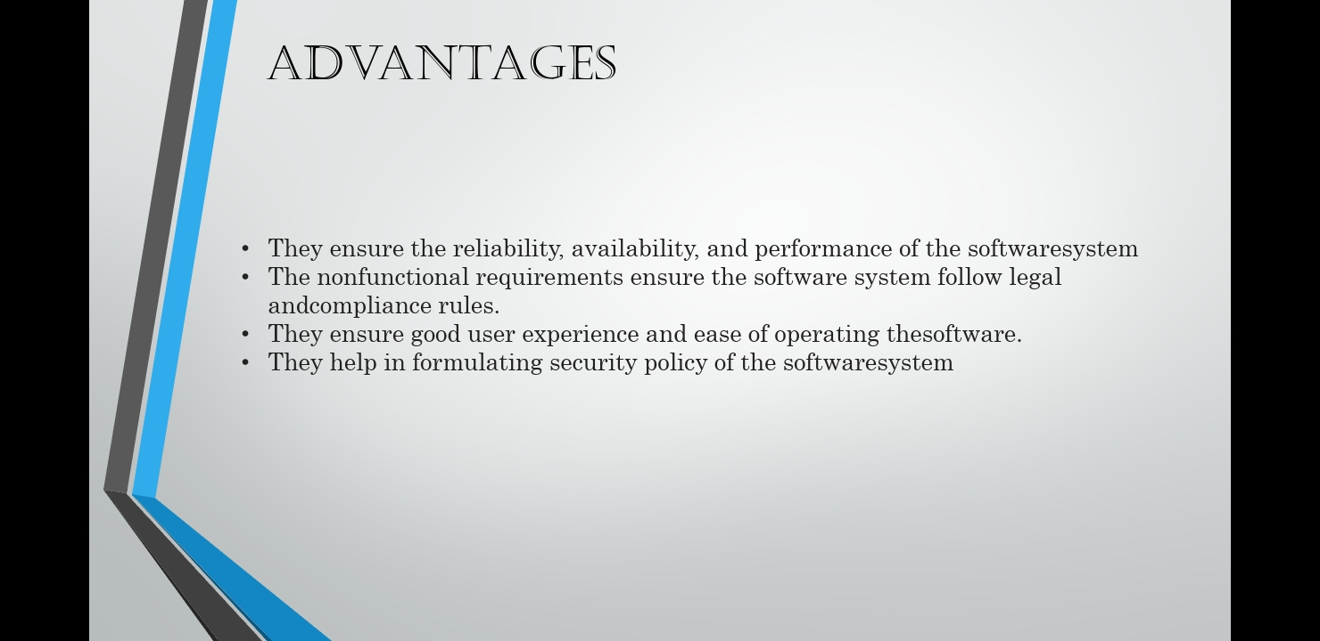
ADVANTAGES

Slide 9
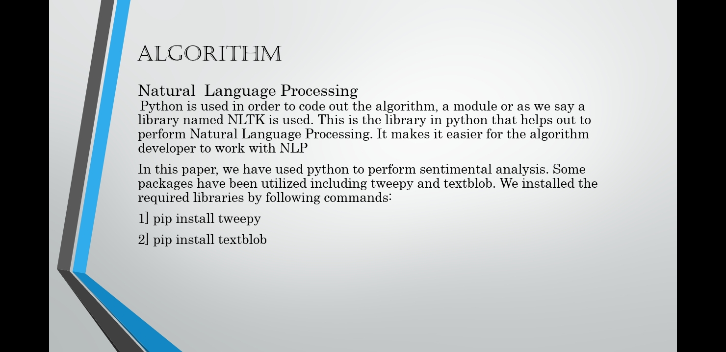
ALGORITHM

Slide 10
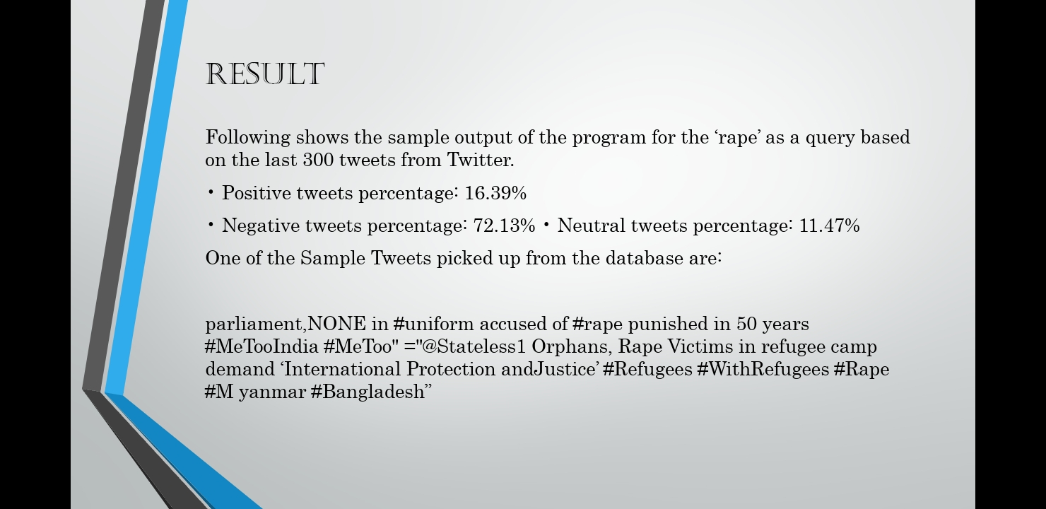
RESULTS

Slide 11
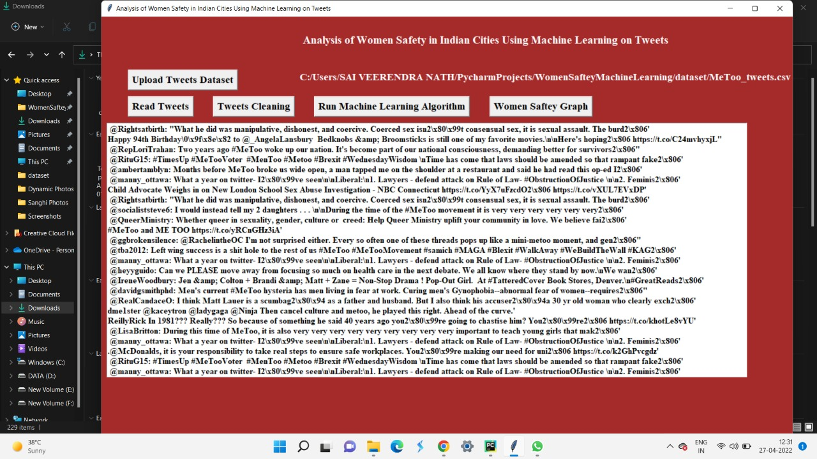

Slide 12
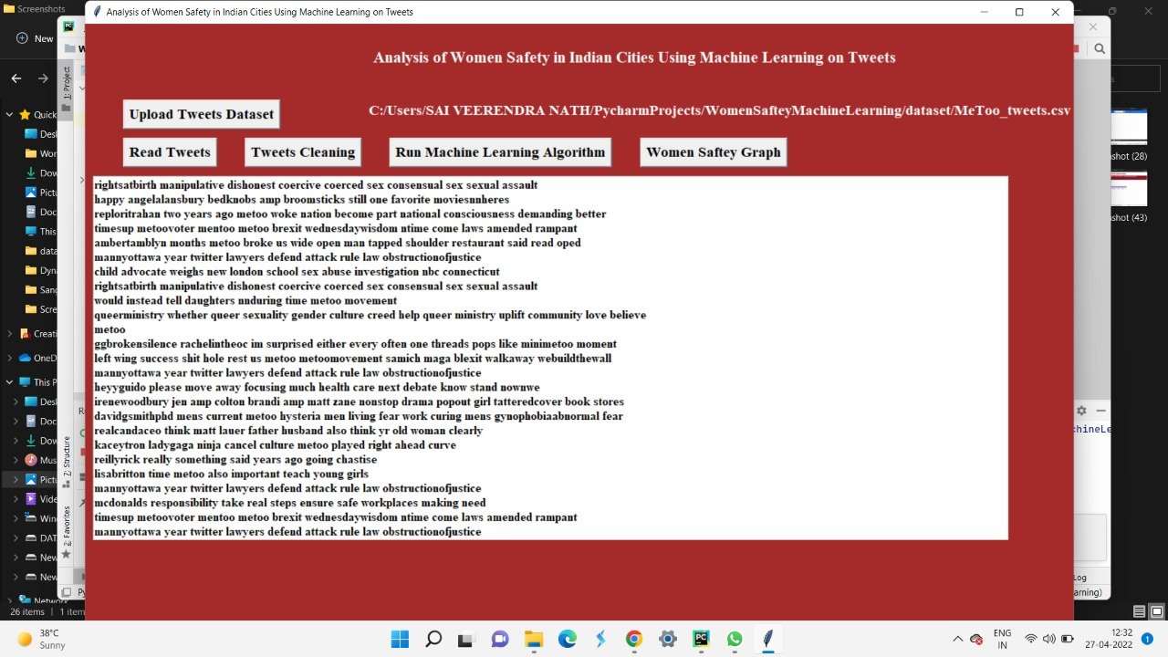

Slide 13
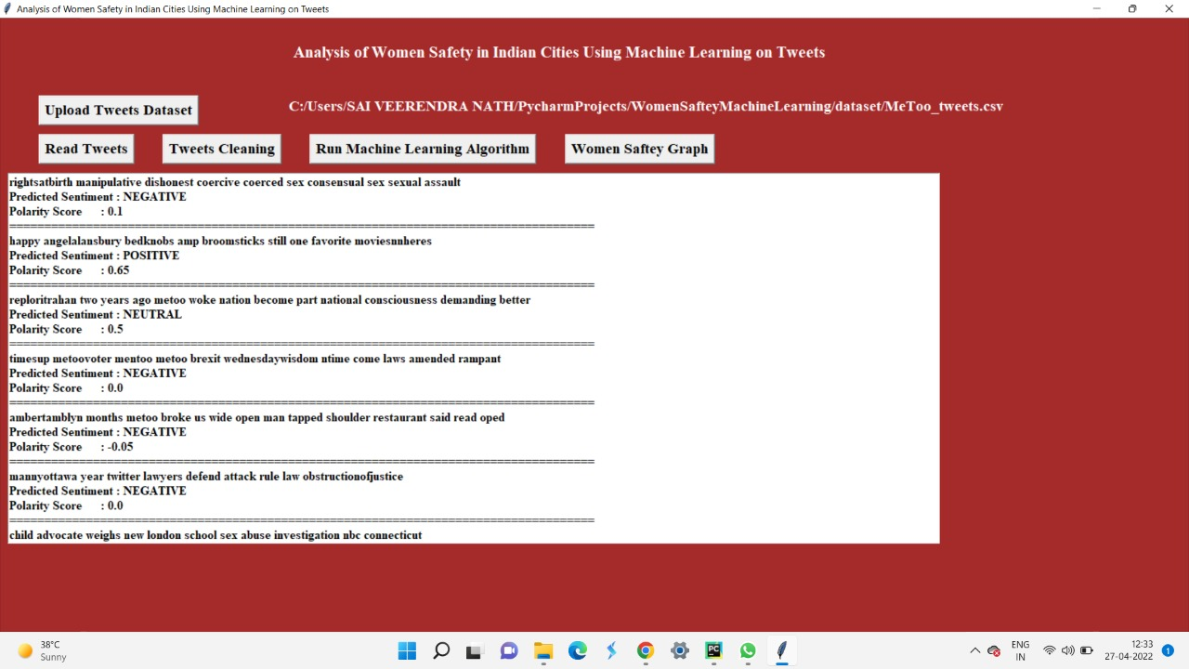

Slide 14
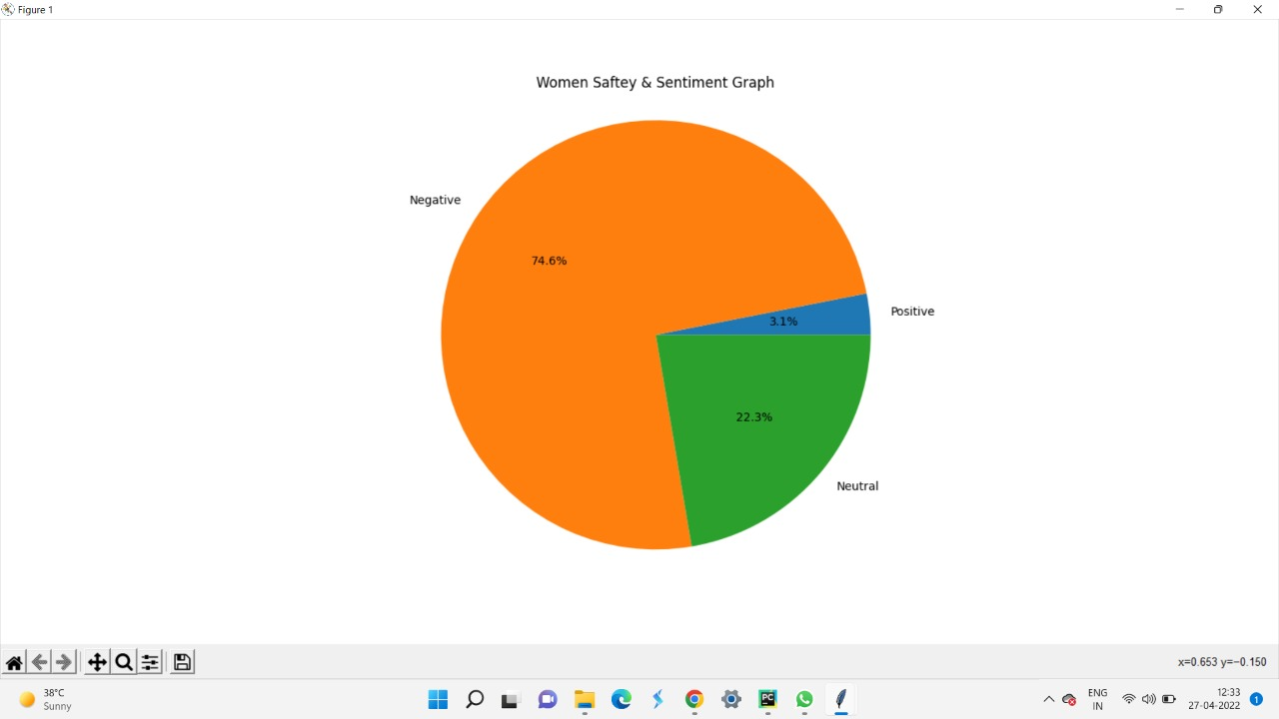

Slide 15
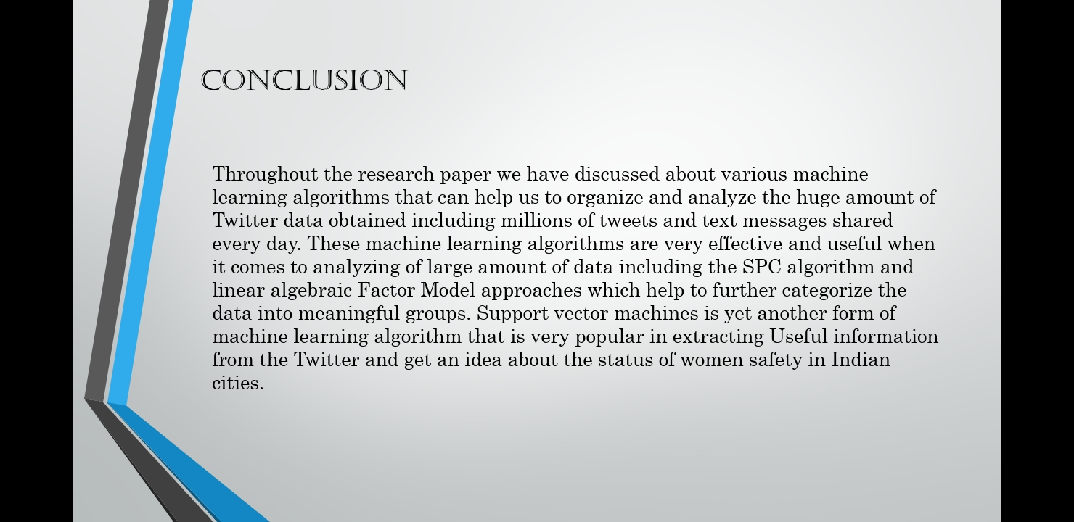
CONCLUSION

Slide 16
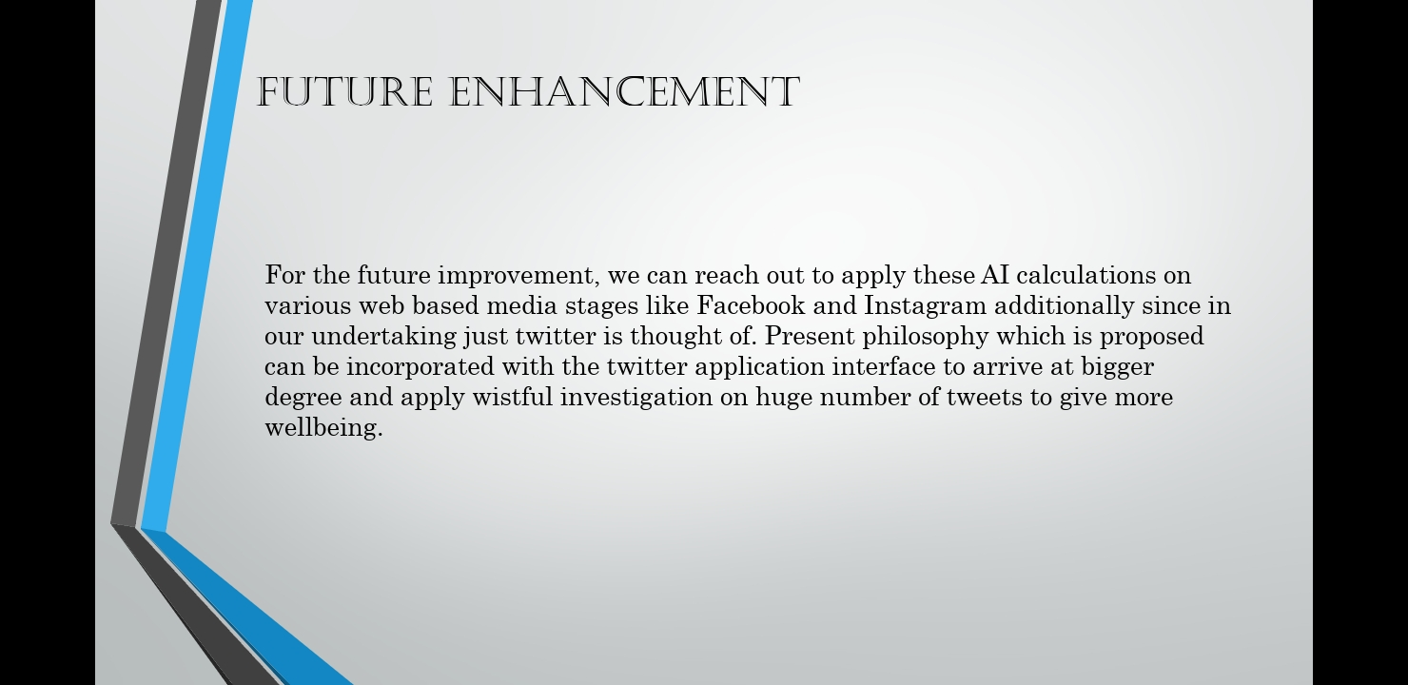
FUTURE ENHANCEMENT

Slide 17
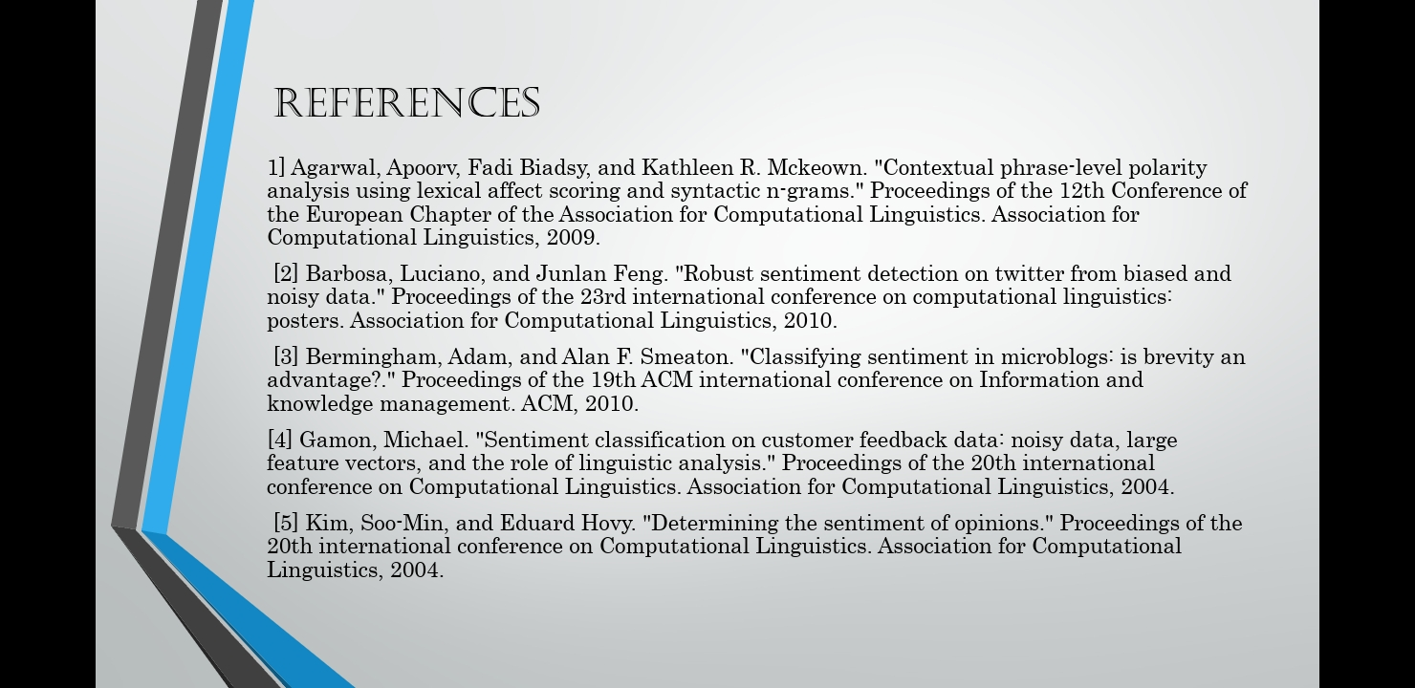
REFERENCES

Slide 18
THANK YOU

